Slide 1

Scaling Up
Notes:
Scale up as in we're going to deploy across the globe
Scale up as in larger development team, more build slaves, slowing down builds means we need to parallelize

Slide 2
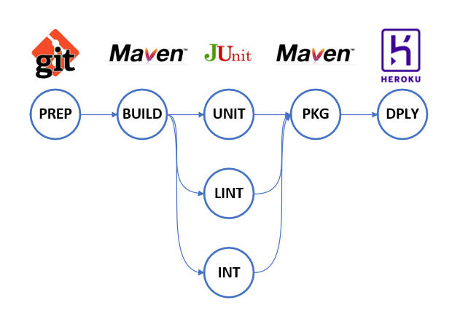
Parallel tasks in a pipeline
Notes:
Reasons
Large/long build – split tests into batches for faster turnaround
Ers story – mid of night check ins

Slide 3
Making pipelines themselves parallel
How long are your stages taking?
What do you think can be split up and how?
Shift to the left: Can your test suites be designed in a way that allows them to be run in parallel from the start of development?
Microservices?
Notes:
Examples from eRS and TalPay
Ask audience how long the builds on their projects take and what ideas they have for arranging modules and microservices.

Slide 4
Exercise: Parallelize existing build
Convert your testing & static analysis stages into parallel
Hint: look up the parallel keyword online
Once you have two stages running in parallel, introduce more.
Experiment with multiple echo and wait commands – what order do these appear in the console output? Would this be clear or confusing to the development team if the output was more complex (e.g. stack traces of tests being run?
Advanced: in the next exercise pipelines invoke other pipelines in parallel – what are the advantages and disadvantages of this?
Notes:
Candidates should see variation of the logging in the console output, e.g. A B A B A B.
Separate pipelines allow the logs to be viewed separately, so only the results of the failing fork need looking at.
But if too highly parallelised, high cost in multiple spot instances.
Tests may break if not designed to run in parallel, behaviour of builds is unpredictable. (Compare to multithreaded applications and the challenges they raise).

Slide 5
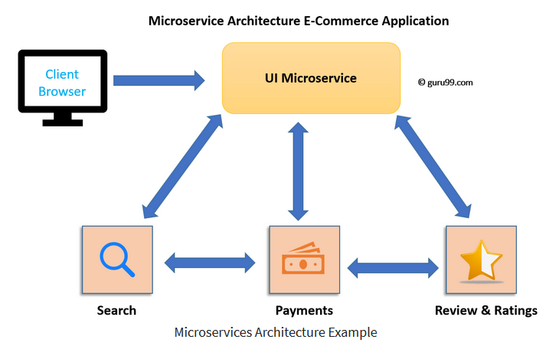
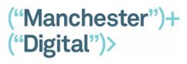
Microservices
Notes:
We mentioned microservices briefly yesterday when talking about architecting your software as a set of independent, modular components.
Taking this idea to the next scale up means your large-scale application is broken into independent mini-applications called microservices.
For example a typical e-commerce would consist of standard features like Search, Ratings and Payments, each of which can be a separate microservice, called out by a User Interface Microservice.
Means you can duplicate – or as we say ‘SPIN UP’ more copies of a service if there is a surge in demand.
Means you can drop in ‘off the shelf’ services that you’ve bought rather than bothered to develop yourself.

Slide 6
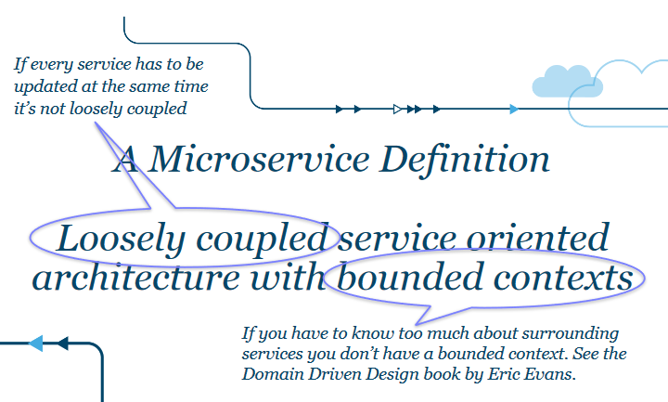
Microservices: natural inhabitants of containers
Notes:
Means you can duplicate – or as we say ‘SPIN UP’ more copies of a service if there is a surge in demand.
Means you can drop in ‘off the shelf’ services that you’ve bought rather than bothered to develop yourself.

Slide 7
When one job isn't enough
Downstream jobs
Natural where the code is very different
e.g. different code language or framework
Allows for running tests for only the components relevant to a team
But CI server can get very complex as too many pipelines are introduced.
Can the pipelines be maintained properly?
Does a change to the architecture or build scripts require changing all the pipelines separately?
Notes:
Sometimes we need one build job to trigger another build job, for instance if we change a common library which we use in multiple projects we might (Emphasize might!) want one or more downstream jobs to run after we've successfully built the initial job
We might simply want one of our stages in our pipeline to be a different job, that's not part of the pipeline directly. For instance integration or UI tests.
Examples from e-RS of using global libraries for code re-use: changing code in one place to propagate across all the pipelines at once.

Slide 8
Parameters
Many types of parameters
Could point to a specific branch in github
May provide environmental values
Can be used to let downstream jobs know some of the variables/environment from the upstream jobs, e.g. Github SHA
Customise behaviour e.g. should the build fail on the first test fail or continue to run the whole suite?
Feature toggles

Slide 9

Exercise: Build parameters
Investigate the parameters the user can enter when they run the build.
Make use of the parameter in your code, for example a checkbox for whether the integration tests should run.
Test your pipeline by running with different combinations – does it run the integration tests when the box is ticked and skip them when not ticked?
Hint: Be careful with whether a boolean or String type is being generated by Jenkins. Can you cast the type from boolean to String and back?

Slide 10
Exercise: Trigger downstream jobs
Copy your build job, so that you have two jobs. Make one job do all the stages except the integration tests, and the second job just the integration tests
Make the first job call the second job as a downstream job
Check the second job can be run by itself.
Explore the build parameters: have the first job pass on a variable the user selected to the second job.
Create a job that represents running a slice of integration tests and call the same job in different ways.
Hint: Use a for-loop to call the build with slice 1, slice 2.... slice 10.
Notes:
Guide the apprentices to the Groovy generation screen and the env documentation if stuck.
The typing gotcha here is if whether the parameter is referenced directly myParameter or as an environment variable env.myParameter
[1..10].each { pipelineCodeHere } is the easiest way to do the for loop.
There is subtlety around the "" or '' String styles and ${} interpolation apprentices will pick up as they develop the code to pass the variable through.

Slide 11

Containers

Slide 12
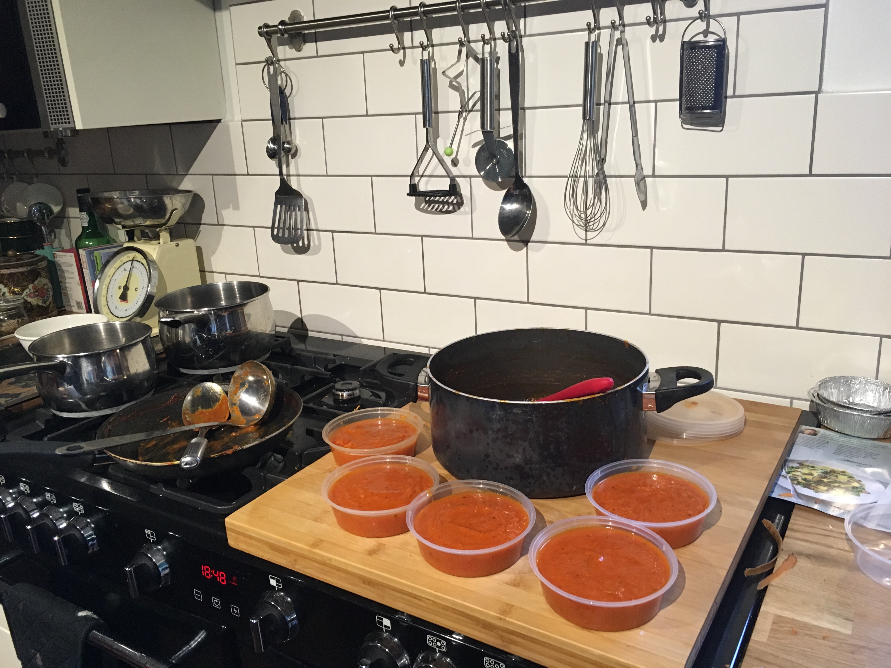
What problem do they solve?
Notes:
Like we usually do, let's ask what problems Containers actually solve, before we wax lyrical about them.
The best example was something my wife said on Monday night:
She was doing 'the weekly tomato sauce run' where we make a panful of the stuff.
We use some for tea that night, then want to freeze the rest.
And here's the problem: we make it in that big black pan right there.
That makes a lot of sauce. The capacity is great. It is a big black beast of sauce making.
We could freeze that – no problem.
But when we want to use it, we have to unfreeze the whole lot.
Most of that excess capacity would then be thrown away.
So, we divide it up into smaller pots and freeze those.
We get one pot out, defrost and leave the others available for later.
Now, I fully understand if I've lost you at this point! What has this got to do with containers in computing?
[ -> ]

Slide 13
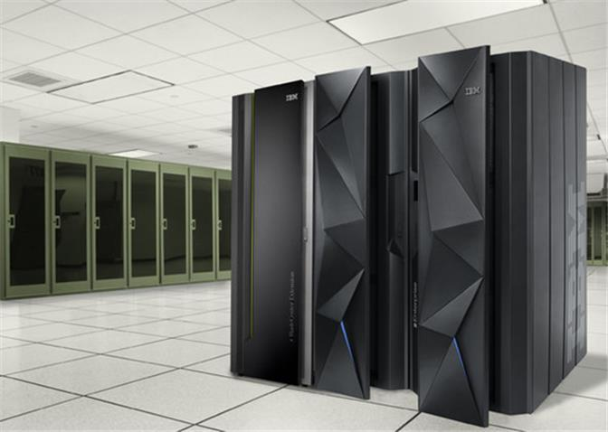
Notes:
This big black beast is a modern mainframe from IBM: The iSeries mainframe.
Far from being old fashioned, it is awesome: massive data, massive HTTP connections, massive disk, massive speed, massive redundancy.
Did I mention "massive cost?"
(If World War 3 kicks off, I'm hiding inside one of these)
But if you buy such a big computer for your web site hosting - anticipating the entire world will log on – what happens if only three people and your mum access it?
The whole computer goes to waste.
In deployment terms, we might only deploy the one app to this entire beast.
It is the big black pan of computing sauce: Big - but far too much to use up all at once.
A container is a piece of software that divides this Big Beast up into smaller computing pots.
It makes it much easier to divide the power up between lots of smaller deployments that may – or may not – need its vast power.
The container allows us to stick several smaller pots of computing sauce into the freezer – ready for when we need them.

Slide 14

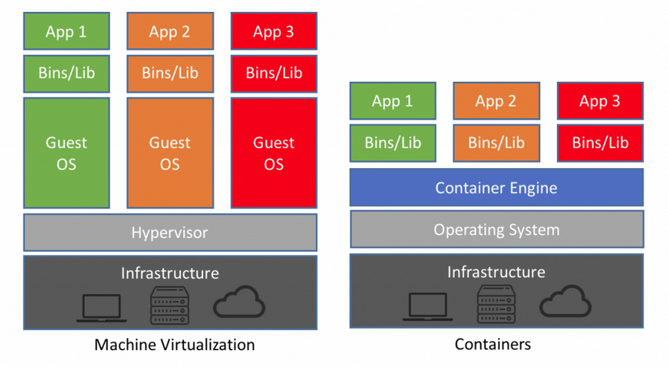
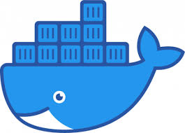
Lighter than Virtual Machines
Notes:
Containers are an advance on the older technology of Virtual Machines.
They did the same thing – allowing you to divide up excess computing power.
But they had several disadvantges.
Virtual Machines take too much system resources – Gigabytes in Size
Containers are ‘light’ - Megabytes in size.
Containers are faster – don’t have to ‘spin up’ a whole Operating system.
They are predictable over packages
Have a look at the graphic.
What you are looking at is that a container takes an operating system, some environment variable, libraries, binaries, shell scripts, tools, paths..
It has everything you need to run your app in a well-known environment.
Nothing is left to chance.
The operating system in the container is the one your application runs on – not the host OS on the real hardware.
So you can run a dozen linux based applications on a Windows box – but your app has no clue that Windows is there. It only sees Linux.
And it only sees the precise version of Linux that you built into the container image.
Can you see how powerful that is? Your hardware no longer matters: AT ALL.
The side benefit is that you divide your one massive server into dozens of smaller virtual servers that you can easily spin up as needed.
https://blog.netapp.com/blogs/containers-vs-vms/
https://www.softwaretestinghelp.com/container-software/
https://techbeacon.com/enterprise-it/essential-guide-software-containers-application-development
Docker is the most popular container right now.
When you want to start it up, just use the ‘docker run’ command to run it anywhere the docker daemon is supported and running. It can be on your laptop, your production server in the cloud, or on a raspberry pi.
Regardless of where your image is running, it will behave the same way.
Why they are good for deploying to AWS /cloud
You can build locally, run on your machine –then the exact same container can be run anywhere getting rid of ‘it works on my machine”
Can mimic the prod env – eg you can build on windows while mimicking a Linux env
How we handle configuration
Configuration as code

Slide 15

Container Orchestration
Companies deploying 10 or so containers, across 4 applications would be still manage to handle them manually, but scaling up to 1000’s of containers and hundreds of services and it’d quickly defeat even the best team.
So introducing yet another layer of automation – container orchestration.
Notes:
Companies deploying 10 or so containers, across 4 applications would be still manage to handle them manually, but scaling up to 1000’s of containers and hundreds of services would quickly defeat even the best team.
So introducing yet another layer of automation – container orchestration.
This is another hot new space in the IT world
When you use a container orchestration tool, like Kubernetes or Docker Swarm (more on these shortly), you typically describe the configuration of your application in a YAML or JSON file, depending on the orchestration tool. These configurations files (for example, docker-compose.yml) are where you tell the orchestration tool where to gather container images (for example, from Docker Hub), how to establish networking between containers, how to mount storage volumes, and where to store logs for that container. Typically, teams will branch and version control these configuration files so they can deploy the same applications across different development and testing environments before deploying them to production clusters.
https://blog.containership.io/k8svsdocker/
https://blog.newrelic.com/engineering/container-orchestration-explained/
https://www.datadoghq.com/container-orchestration/

Slide 16
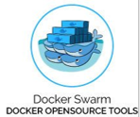
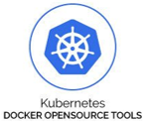
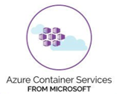

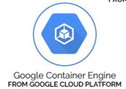



Current Orchestration Tools
Notes:
The top row shows the most commonly used orchestration tools at the moment: - primarily Kubernetes.
To keep the variety of layers straight in your head, try the analogy of: -
Packaging – sticking your software in a cardboard delivery carton
Container – placing your many cartons in a shipping container
Orchestration – the boat and ports that coordinate and move around all your shipping containers

Slide 17

Cloud Computing
Notes:
[TITLE SLIDE]

Slide 18
What is 'Cloud' ?
Shout out your ideas!
Anybody using 'cloud' at work?
How would you explain it to a friend?
Notes:
[SHOUTOUT to audience]
Wrap up with - 'Ok … the best way to understand cloud is to consider what problems it solves for us'

Slide 19
What problem does Cloud solve?
Servers are an expensive up-front outlay
What if our app generates no money?
Servers are hard to manage
Security patches
OS upgrades
Disk fail. Motherboard fail. Network card fail.
How many servers do we need?
How many users are we going to have next year?
Notes:
The best way to understand cloud is to understand what problems it solves.
Deploying to our own servers is a bit of a minefield.
We have to buy them up front.
They are expensive – and we simply don't know if our app will make any money yet. That's risky.
Servers need capable sys-admins, who know about security, OS patches, hardware changes. These are all specialist ( ka-ching! ) skills.
And how many servers do we need to buy? That totally depends on the success of our app – that we have not launched yet. More risk.

Slide 20
Cloud: Shift Left of hardware
What if we got someone else to do it?
Server paid for by someone else
Server configured by someone else
Server managed and maintained by someone else
Problems Gone!
Save money
Save time
Save staffing
Notes:
Cloud computing means lots of things to lots of people.
But why is it so popular?
It is simply continuing the shift left. Doing things earlier. Shifting risk to somewhere else.
In this case, instead of waiting until the end of the project to choose hardware and set it up -
What if we pay somebody else to do all that?
What if we simply rent hardware fully set up and fully maintained by somebody like Amazon, Microsoft or Google?
That's Cloud in a nutshell: We rent servers from other people.
Somebody else pays the outlay, takes on the financial risk and hires the expert staff needed.
We just pay per use.

Slide 21
Cloud Advantages
Don’t run your own hardware
Don’t run your own software
Expert handling of Security concerns
Convert CapEx to OpEx
Pay only for what you use
Access to compute services and scale
Repetitive, heavy lifting done for you
Automation of systems
Fewer operations greybeards required
Enables ‘DevOps’
Pre-built services like databases, email systems, message queues
Notes:
This slide lists some of the many advantages of using Cloud computing.
I'll point out a couple here that really help us:
* We get access to HUGE SCALE. We can rent thousands of computers for a short time if we need to. Like for a Christmas Sale.
* We can use PRE-BUILT, fully managed services like databases and email systems. Huge saving in time.
* For emphasis: We only PAY FOR WHAT WE USE
This last one is HUGE.
It levels the playing field between a huge corporation like Microsoft and a single developer.
We can write an application that can scale to billions of users – but we don’t have to pay for them until we get them.

Slide 22
Why not Cloud?
Data sovereignty
Encryption mitigates this: data in flight and at rest
Regulatory reasons
medical, defence industries place restrictions on server location
All your eggs in one basket
But: Is that worse than hosting it on your own kit?
It's not right for everything:
Notes:
You can't use Cloud for everything, though – despite what providers might lead you to believe.
The big issue is 'Who can access my data without me knowing?'
There is a risk and a perception that hosting sensitive data on somebody else's servers puts it at risk
Encrypting that data mitigates this, but that's not enough in some industries.
Defence for example: Can you see UK government hosting sensitive data on a foreign powers' Cloud system?
Regulatory reasons limit where cloud can be used to limit risk of misuse of stolen data
A third corporate reason is valid: Does my company trust your cloud? What if your cloud goes down?
To some companies, this feels like a risky 'all eggs in one basket' option.
But is it really? It can happen to your own servers, too.
But there's a board-level decision to be made here – and it's arguable both ways.

Slide 23
Cloud History
2000 Virtualisation
2006 Amazon EC2
2010 Microsoft Azure
2016 Serverless
2012 Google Cloud
2008 Google App Engine
This is all quite new ...
Notes:
Cloud computing started around Year 2000 in web hosting companies who first had these problems.
Lots of users wanting sites hosted – but some users had heavy traffic, others didn't.
Hard to know how many servers to buy.
Early attempts used virtualisation – essentially running a OS inside an OS to create 'virtual hardware' - the fore runner of Containers today.
Amazon then took an early lead releasing EC2 – their 'rent a server' offering in 2006.
For them, it was a way to monetize the computing power they didn't use on any given day: smart.
Google and Microsoft followed suit over the next few years, offering 'rent a server' services.
The most recent advance in 2016 – and it is a game changer – is 'Serverless computing'.
We're not going to cover this – but you really should check it out:
"What iof we could just rent the inside of a function, in a running server, and just paste in the code?"
Extreme shift left of hardware.

Slide 24
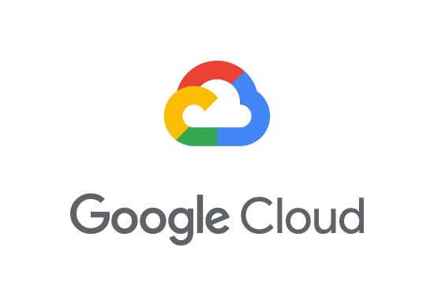
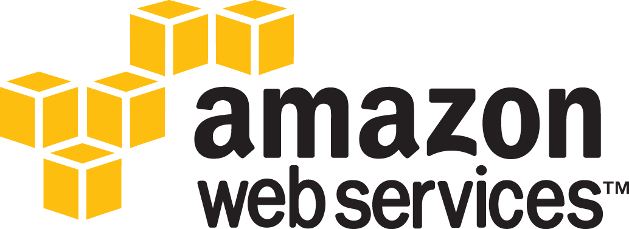


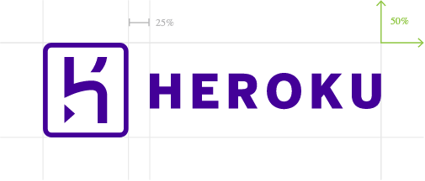
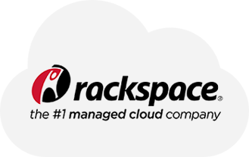


Cloud Providers
Notes:
Today, Cloud Computing is a crowded space with many top players offering services.
The top three we see in BJSS are Amazon, Microsoft and Google.
It's fair to say that our projects tend to use Amazon or Azure.
And of course BJSS is an official Amazon Certified Partner for AWS solutions –
and we run the Amazon Restart program that retrains ex-military staff.
Now – they make good DevOps people. Talk about being calm under fire ...

Slide 25
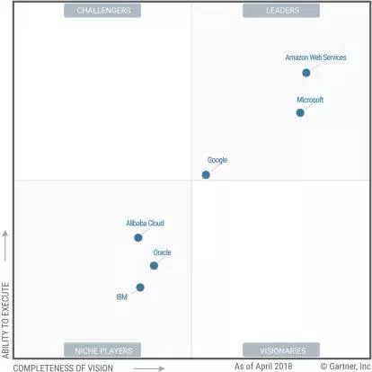
Winners and losers of the Cloud war
CHALLENGERS
LEADERS
Amazon Web Services
Microsoft
Google
Alibaba Cloud
Oracle
IBM
NICHE PLAYERS
VISIONARIES
Notes:
To help you get a feel for 'how good' each of those providers are, research company Gartner produce an annual matrix.
Further to the right means 'Offer more services'.
Further up means 'More mature and reliable'.
Every single year, the top prize goes to Amazon Web Services – and rightly so.
We're going to cover some of the hundreds of AWS services – and how you can use them - in our next talk

Slide 26
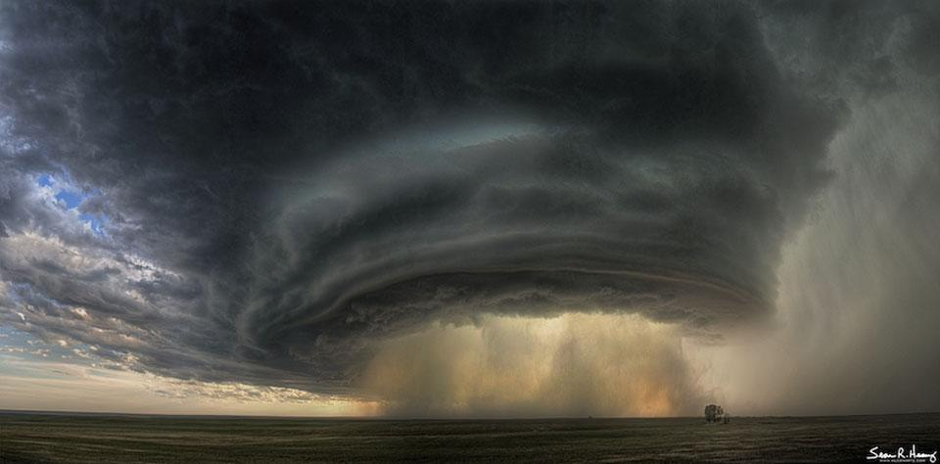

Sometimes, a Cloud is 'Dark' ...
BOTNETS
Notes:
Worth mentioning before Tea: Dark clouds.
Commonly known as 'Botnets'.
When properly bad guys want to use computers to do bad things – they don’t want to leave a trail.
So they use your computer. And all the computers connected to it.
All their bad deeds look like you did them …
It's why the single most important thing we can do as Cloud developers is constantly think about SECURITY.
Securing your application – securing your network – locking down permissions.
Otherwise, you might get a knock on the door for running the world's biggest illegal Crypto currency scam – without you ever knowing it.

Slide 27

Tea Break
Notes:
After the Tea Break, we're going to move on to the leading edge of deployment – Cloud Native with AWS

Slide 28

Cloud: Getting Setup

Slide 29

A closer look at AWS
Market leader
Robust service levels
Reliable and responsive support
Solid feature set
Though there are some oddities
More off-the-peg services than anyone else in the market
Notes:
Has been Market leader for a long time, though the gap is closing with Azure catching up
Robust service levels
Reliable and responsive support
Solid feature set
Though there are some oddities -→ like what?
More off-the-peg services than anyone else in the market
Some would argue some of the services are ‘shovelware’
That is, not totally fit for purpose but there to pad out the list of services AWS offers
But many/most of them work well

Slide 30
Why AWS?
Better support from third parties than any other cloud service
Better developed training and ancillary services than any other provider
Highly developed partner system (including BJSS!)
Global reach - AWS regions on every continent except Antarctica, often in multiple locations
Extremely impressive client list
Client opinion of AWS is also very high
Backed by massive company
Security accreditations suitable for most sectors

Slide 31
Why not AWS?
Some architectural quirks due to being first to provide many services
More recent cloud providers (e.g. Google Cloud Platform) have been able to see what worked and what didn’t on AWS and design around that
Difficult for Amazon to change some of their core architectural decisions due to their size and existing customer base
Not all AWS services are brilliant
Some are clearly alpha/beta quality despite what Amazon says
While prices have come down markedly and Amazon continue to reduce prices, they often end up a little more expensive than their bigger competitors
Notes:
Some architectural quirks due to being first to provide many services
More recent cloud providers (e.g. Google Cloud Platform) have been able to see what worked and what didn’t on AWS and design around that
Difficult for Amazon to change some of their core architectural decisions due to their size and existing customer base
Not all AWS services are brilliant
Some are clearly alpha/beta quality despite what Amazon says
While prices have come down markedly and Amazon continue to reduce prices, they often end up a little more expensive than their bigger competitors
Market leader concerns
Some(?) evidence they are getting more hard-nosed towards their customers recently
Competitors finally beginning to chip away at their market share
American company
Concerns over data sovereignty when entrusting your data to a company subject to USA PATRIOT act - even if the data is hosted in a non-US region
All their big competitors have this problem too

Slide 32
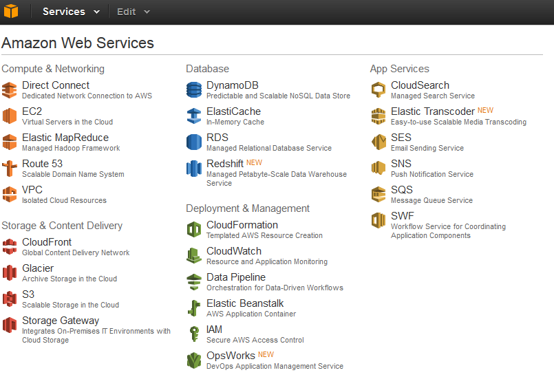
Notes:
This is the list of Services presented to you to choose from when you sign up to an Amazon account and reach the control Console.
As you can see, it is a a bewildering buffet of choices. Helpfully grouped by function.
Ones of interest to you relating to this bootcamp are: -
ECS (Elastic Container Service) ?? Maybe?
Lambda (Function as a Service)
SQS (Simple Queuing Service)
SNS (Simple Notification Service)
SES (Simple Email Service)
API Gateway
CloudTrail (Audit logging)
CloudWatch (Monitoring and application logging)
CloudFormation (Infrastructure as Code)
CloudFront (AWS’s Content Delivery Network)

Slide 33

AWS Services
Lots!
EC2 (Elastic Compute Cloud)
S3 (Simple Storage Service)
EBS (Elastic Block Storage)
IAM (Identity and Access Management)
DynamoDB (NoSql database)
Route53 (DNS management)
ELB (Elastic Load Balancing)
Amazon get zero marks for good naming choices for their services:
Happily someone at Expedited Security put together this sarcastic demystifier:
https://www.expeditedssl.com/aws-in-plain-english
Notes:
There are many (over 100!) cloud services available on AWS
The core services that the rest are built on are: (go into list)
EC2 (Elastic Compute Cloud) - the core virtualisation platform, similar to e.g. VMware
S3 (Simple Storage Service) - storage of files and objects via HTTP
EBS (Elastic Block Storage) - storage of files and filesystems on traditional ‘disk-style’ storage
IAM (Identity and Access Management) - AWS user accounts and policies
DynamoDB - highly available distributed database that doesn’t use SQL (NoSQL)
Route53 - internal and external DNS
ELB (Elastic Load Balancing) - load balancer and failover services
Amazon get zero marks ‘the cone of shame’ for good naming choices for their services: alphabet soup is no one’s first choice!

Slide 34
A Modern Website
Let's design a modern web site, AWS 'Cloud Native':
No single 'application server' - no Heroku here
Modern architecture – React/JSX front end, Kotlin backend
We need a place to host the Kotlin server code
We need a place to host the JavaScript code
Public access to these severs for web browsers
Notes:
[READ SLIDE] . - set scene for the kind of app we will build

Slide 35
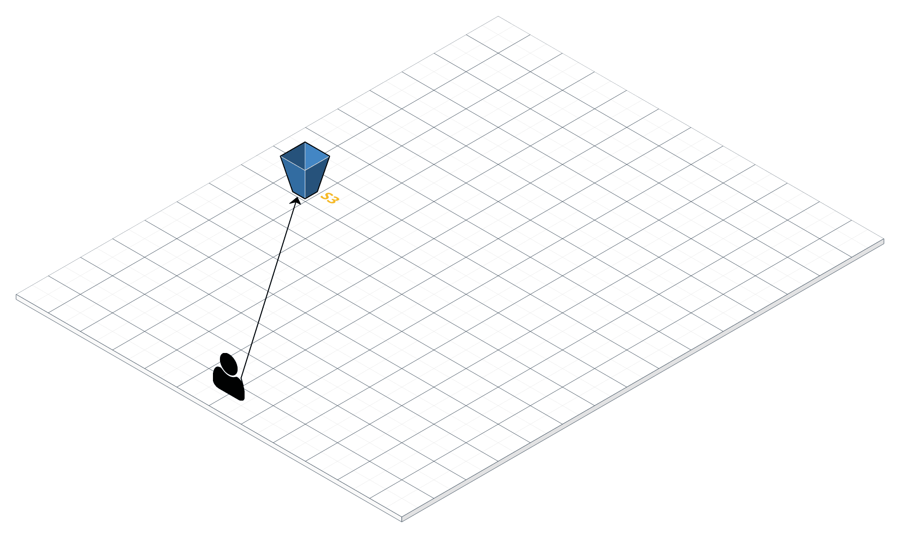
Cloud Architecture
£0.43 per month
- Cannot use SSL
- dns name fixed
http://websitetestdevapps2019.s3-website.eu-west-2.amazonaws.com
Notes:
So, starting to build up some architecture, here we have AWS S3 hosting a static web site :
- S3 is Amazon's Simple Storage Service.
- You can store any kind of binary data in there
- It is stored in a named "bucket" of data
- You access it by requesting data in a named bucket
- You can declare an S3 bucket to congtain html, css, JS data – and Amazon will put a web server in front of it
- They call this 'S3 static hosting' - there is no server side code to vary what is sent
- But we can send Java Script – so our browser can be sent a fully feature, modern React application
This is a simple solution, with some limitations:
We cannot use ssl
We cannot control the hostname/dns with this setup,
But ….
It's cheap, The 43p per month here covers 10gb of storage, 1,000,000 get's and 1,000 puts
But we get a web scale web site. The front end JS code runs in the browser. It is a full application. We have done ZERO work in getting that site served past our app code.

Slide 36
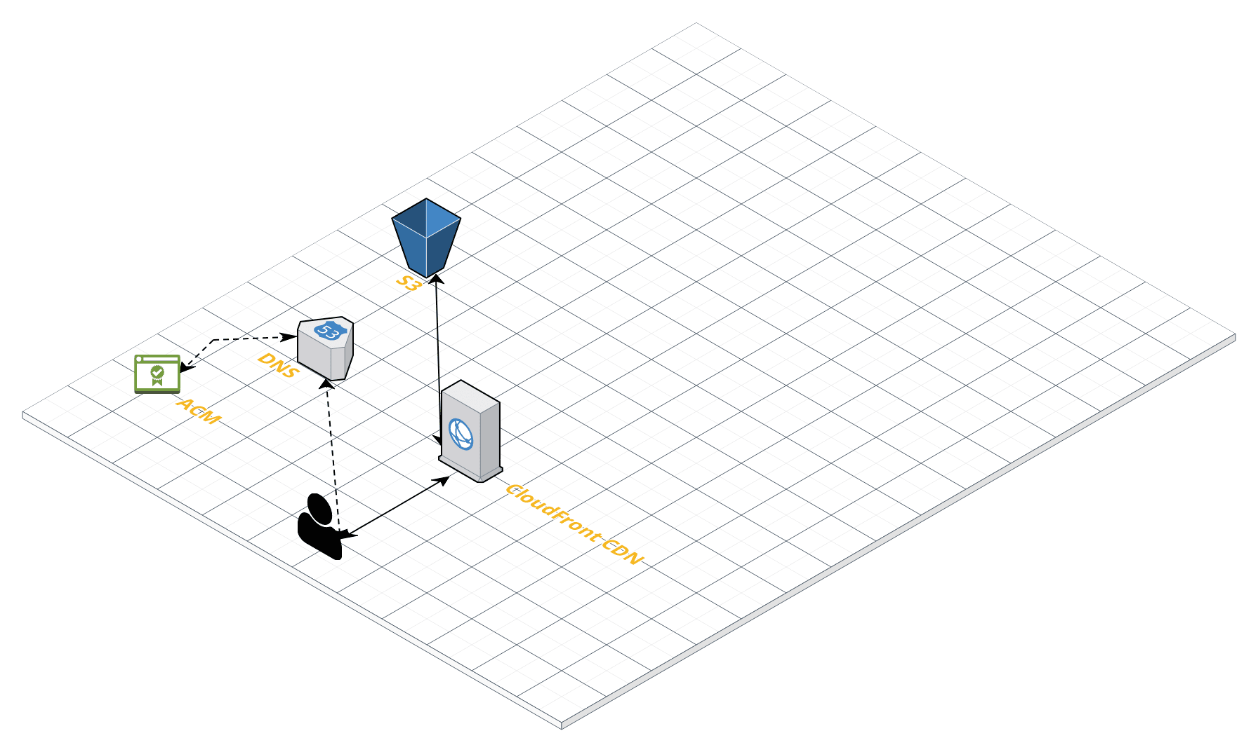
Cloud Architecture
£1.02 per month
- Cannot use SSL
- dns name fixed
http://websitetestdevapps2019.s3-website.eu-west-2.amazonaws.com
Notes:
Adding in Cloudfront with DNS (Route 53) and using ACM to store the ssl certificate details, gets us past the drawbacks of the previous architecture
A little more costly, the SSL Cert, if provided by Amazon is free, DNS costs a little per zone to host, and fractions of a pence per query.
What have we gained?
Cloudfront is a Content Delivery Network, with points of presence all over the world. This means that when requesting a page from the S3 website, it gets cached by Cloudfront in the nearest location to you, and anybody who requests that same web page before it is removed from the cache (24 hrs later generally) will get a much faster response. Probably not noticeable if your users are in the same country in which you deploy the S3 website, but if you have users all over the world, and especially where international internet links are slow, then it will make a big difference.
We now have SSL, and our own domain name

Slide 37
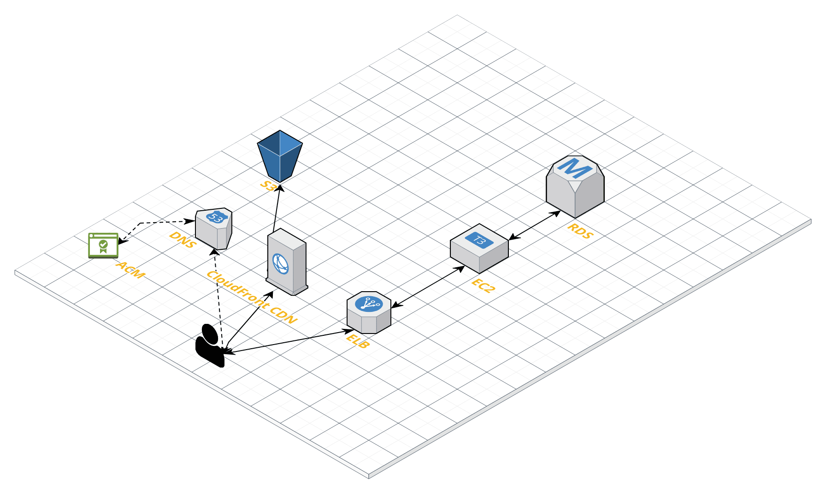
Cloud Architecture
£51 per month
Notes:
Moving on to a more real world situation, if the web application needs to talk and retrieve data from the backend, then we need more services.
In this picture we have a Single Page Application web site (Think Angular or React) hosted on S3/Cloudfront, alongside a microservice (hosted on EC2) and a database (RDS).
The ELB (elastic load balancer) supports having SSL and your own domain name for the API, and can be set to spin up more servers if you get more traffic: you pay for what you use, nothing more.

Slide 38
THINK...
Notes:
Just think about what we have seen:
We have built an infinitely scalable web application, with data stored on a robust back end, powered by a fast, modern React front end.
We've only written a tiny amount of code. Our running costs depend ONLY on the traffic.
Can you see how different this is than writing a full application, with a web server, in a pipeline?
It is completely different. We have to use services that Amazon provide, in the way they provide them.
The reward is that:
* our app code is much smaller
* We don’t reinvent the wheel for storage, load balancers, caches
* Somebody at Amazon gets woken at 2 AM if the server goes down
* We do not pay for the server, ever
* If the server breaks, somebody at Amazon has to get the screwdriver out, not us
This is very nearly the most modern way.
The near future will have a lot more of 'Serverless' computing, typified by AWS lambda.
This is where we don’t even rent a full server – we rent *one single function*.
We literally write the inside of a function and send it to AWS to host in a server somwhere.
This will be HUGE in your careers.
The next challenge is to get started with some of the basic AWS services we've mentions.
Start with S£ as it is by far the easiest to get to grips with

Slide 39
Exercise 9 Setting up AWS infrastructure
Exploring the AWS free tier space: - things you can try
Deployment of Linux instance via console
Bootstrap webservice onto it and access via internet
Deployment of S3 bucket via console, upload file and access via internet

Slide 40
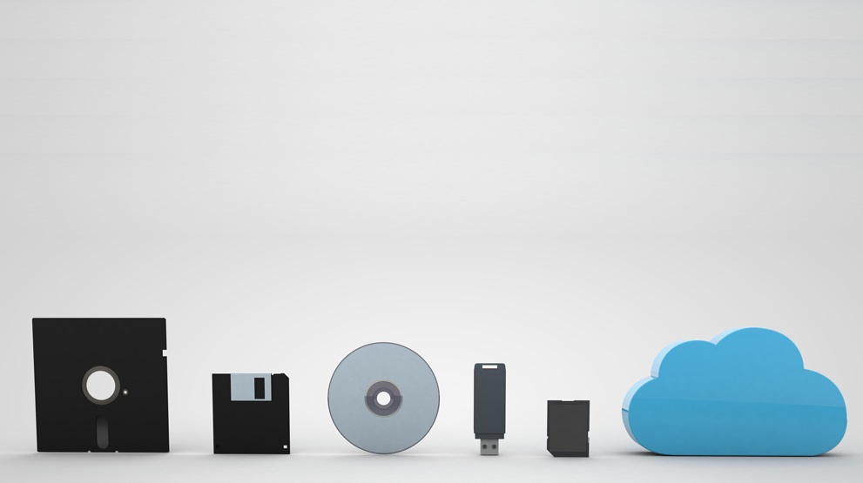
Wrap up
Takeaway and things to explore
Follow Up
Feedback
Notes:
The last two days we’ve taken you on a journey through the increasingly complex and sophisticated world of professional software deployment.
We hope you’ve found it interesting – remember this is just a simplified ‘taster’ of what is going on out there and we hope that you will now recognise some of the concepts and jargon of the field and perhaps even decide to go and explore jobs in this area. At the very least, understanding these challenges this will make you a better developer and
PASS AROUND HANDOUT SHEET

Slide 41
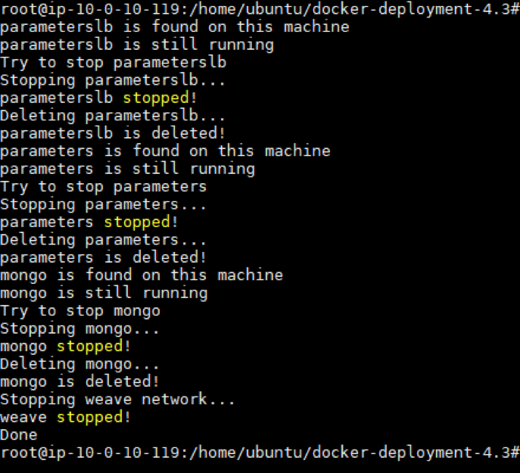
> Goodbye.
Thanks to:
Alan Mellor, BJSS
Marie Cahill, BJSS
Roy Porter, BJSS
Alex Bramham, BJSS
Alec Tunbridge, AutoTrader
Any final questions?
Feel free to ask
alan.mellor@bjss.com
Notes:
Thanks to all our mentors for helping.
Thanks to Marie who has worked long and hard on pulling together good content and exercises.
Thanks to Roy and Alex for the technical know-how in getting these projects to work.
And finally thank you from me, Alan Mellor to all of you for being such a fantastic group of students!
See you in future bootcamps. And when one of you becomes my boss in the future ;)

